Slide 1
INTRODUCTION TO GRAPHIC DESIGN
Graphic and Web Design Class

Slide 2
Meaning of Graphic Design
Graphic design is not just about making things pretty, it is about using design principles to communicate a message clearly.
Graphic design is a craft where professionals create visual content to communicate messages.
Graphic design is the art and practice of planning and projecting ideas and experiences with visual and textual content.

Slide 3
Uses/Importance of Graphic Designer
It plays a great role in communication:
Beautiful designs speak to customers when you are not verbally speaking to them. Looking at a product, logo, banner or website you get a visual message. It has to be attractive so that people don’t get bored. It is a way of distinguishing your brand from others.

Slide 4
It plays a great role in communication

Slide 5
Uses/Importance of Graphic Designer
It gives you a consistent look:
Through graphic design, you can give a unique, customised touch to your brand. For it to be professional, the colours, fonts and logo across all media have to be uniform. This in turn keeps your brand message similar on all the platforms and people can connect with your brand.

Slide 6
Uses/Importance of Graphic Designer
It leads to higher conversions:
Good designs have always been overlooked. But as a matter of fact, a good design which is professional and attractive can attract an audience to your site and tempt them to purchase your product. A great design can convert a business from no sales to a lot of sales.

Slide 7
It leads to higher conversions

Slide 8
Uses/Importance of Graphic Designer
It sets you apart from the rest:
People like to associate themselves with good looking things. So, it is important that you choose the right design to set yourself apart from other competitors and convince your audience about their choices. The quality graphic design significantly increases your chances to stand out in the market and among audiences.

Slide 9
It sets you apart from the rest

Slide 10
Uses/Importance of Graphic Designer
It shows professionalism:
The presentation can actually make your business a great one. People tend to look for companies that are trustworthy and seem professional. Graphic design is a great way to convince people who are looking for signs of professionalism. This develops a perception in their minds about your company and they invest in it.

Slide 11
It shows professionalism

Slide 12
Types of Graphic Designer
Brand design:
Brand design is the practice of setting guidelines and best practices for a company to use across all branded materials to ensure a consistent brand identity. Brand designers help communicate the personality, tone, and core messaging of a company, so this work involves a lot of strategy.

Slide 13
Brand design
Designing logos and setting clear guidelines for how they’re to be used.
Designing letterhead, icons, and various illustrations
Selecting brand colors.
Creating or selecting fonts and typography guidelines
Creating templates that follow the brand guidelines and can be used by marketing, growth, and other teams
Packaging design and graphics for product design

Slide 14
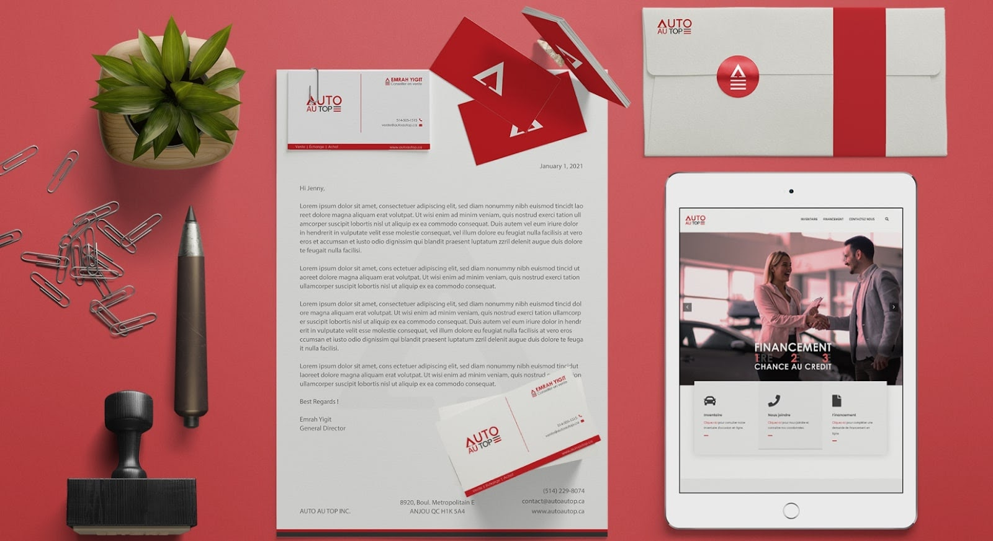
Brand design

Slide 15
Types of Graphic Designer
Marketing/Promotion design:
Marketing design is graphic design for marketing initiatives. Marketing designers may work on small projects, such as the layout of a promotional email, or large multi-faceted projects, such as designing the booth, hand-outs, and print materials for trade shows.

Slide 16
Marketing/Promotion design
emails
newsletters
billboards and other signage
posters
print ads
trade show booths
physical mailers
website assets

Slide 17
Marketing/Promotion design

Slide 18
Types of Graphic Designer
Web/User Interface design:
Designing a great website is a multidisciplinary undertaking because websites are interactive, rather than fixed assets like a brochure or a magazine. You need graphic design skills as well as experience with user experience (UX) and user interface (UI) design, which is why many websites are designed by teams of multiple professionals with complementary skill sets.

Slide 19
Web/User Interface design
Creating icons and buttons
Creating images, illustrations, and other graphics
Designing web page layouts
Creating various interactive design elements on a website
Creating videos and gifs
Helping ensure visual elements are optimized for all devices (desktop, mobile, etc.)
Working with web development, UX, UI, and marketing design teams to improve overall experience for site visitors

Slide 20
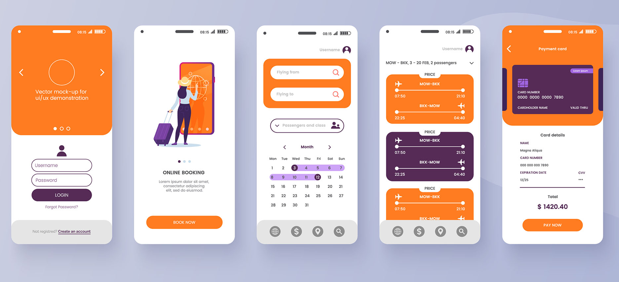
Web/User Interface design

Slide 21
Types of Graphic Designer
Illustration design:
Illustrations are often included as part of web, marketing, and brand design — but they’re also used in other ways. Some designers focus solely on offering illustrations and will work with larger design teams, contributing individual assets for various projects.

Slide 22
Illustration design
children’s books
t-shirts and other wearables
cards and stationary
social media
video and interactive media
marketing campaigns

Slide 23
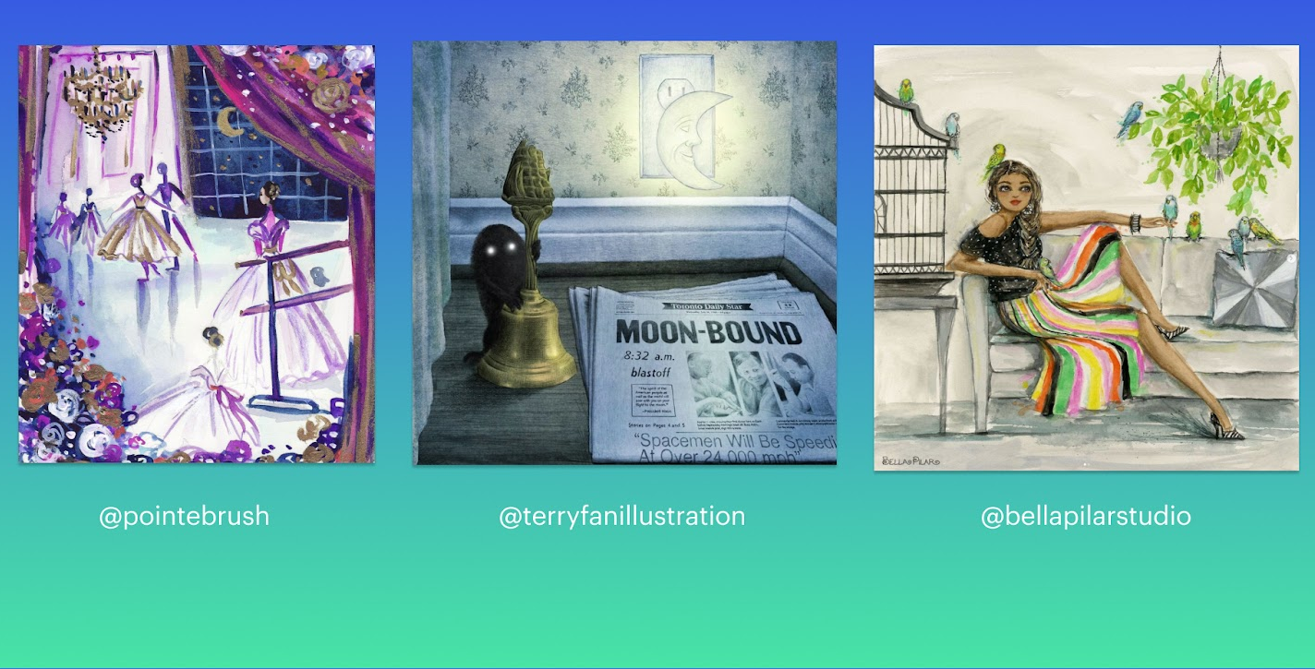
Illustration design

Slide 24
Types of Graphic Designer
Packaging design:
From food to gadgets to designer jewelry, the packaging that items are transported in is often just as important as the items themselves. Product packaging designers aim to show off or complement the items inside the packages.

Slide 25
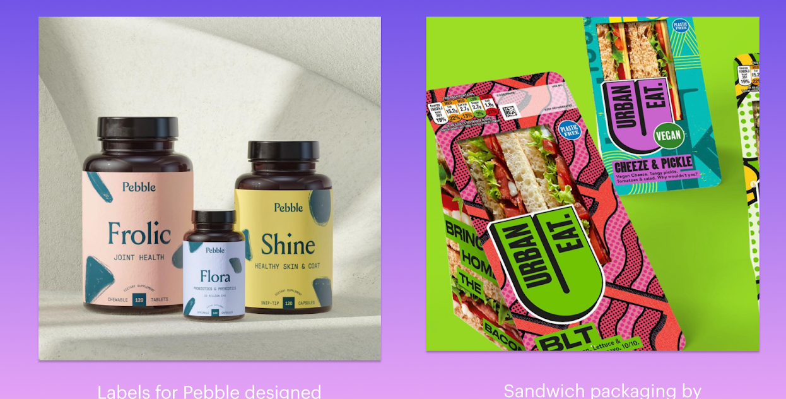
Packaging design

Slide 26
Types of Graphic Designer
Editorial design:
The term “graphic design” originated from editorial graphic design and today it is still a very important part of both print and digital editorial publications. Editorial graphic design helps set the tone for a publication and can amplify the written word.

Slide 27
Editorial design
books
magazines
newspapers
emails and digital publications

Slide 28
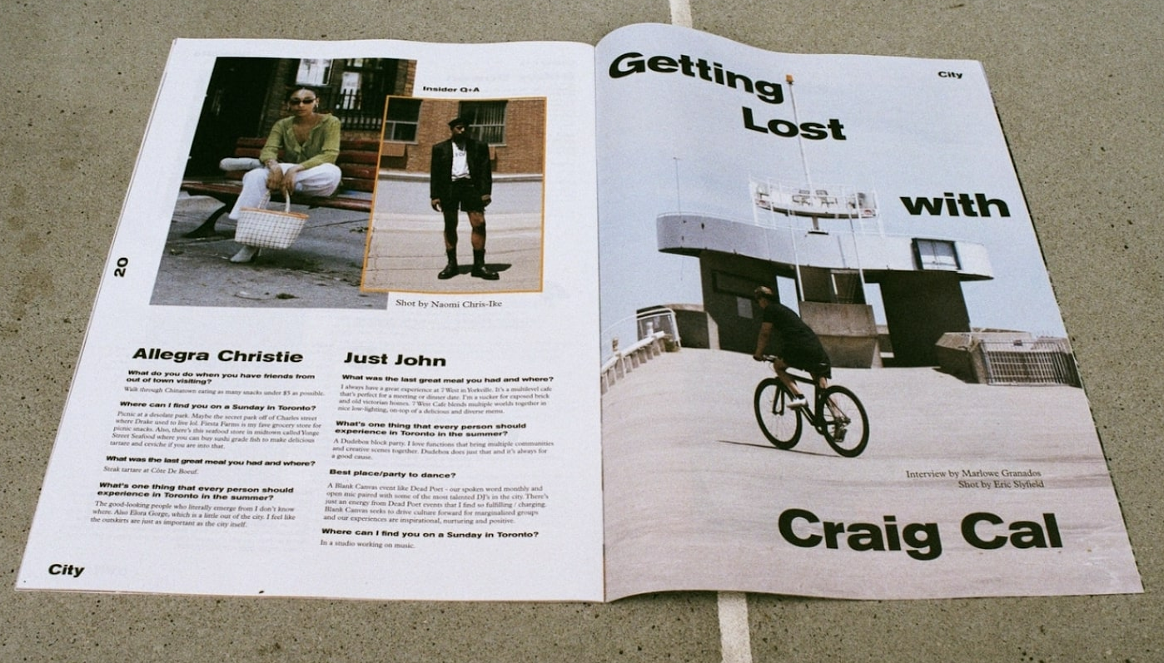
Editorial design

Slide 29
Applications for Graphic Design
CorelDRAW

Slide 30
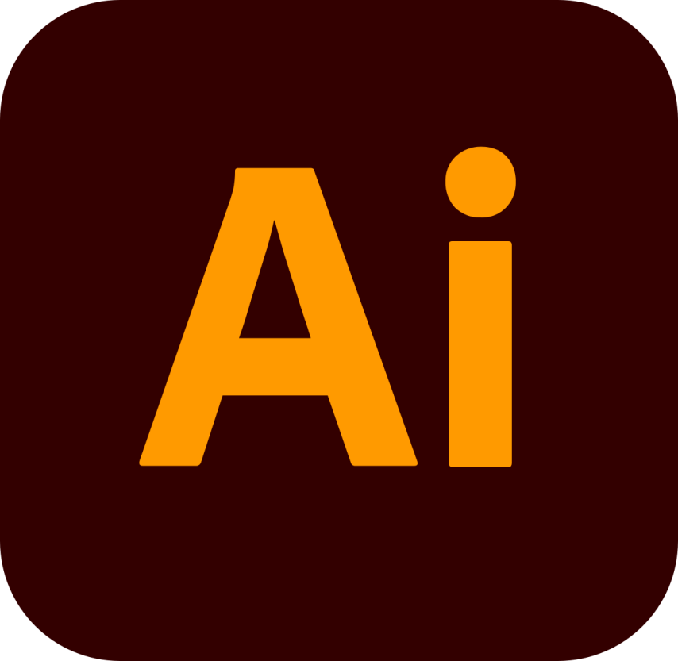
Applications for Graphic Design
Adobe Illustrator

Slide 31
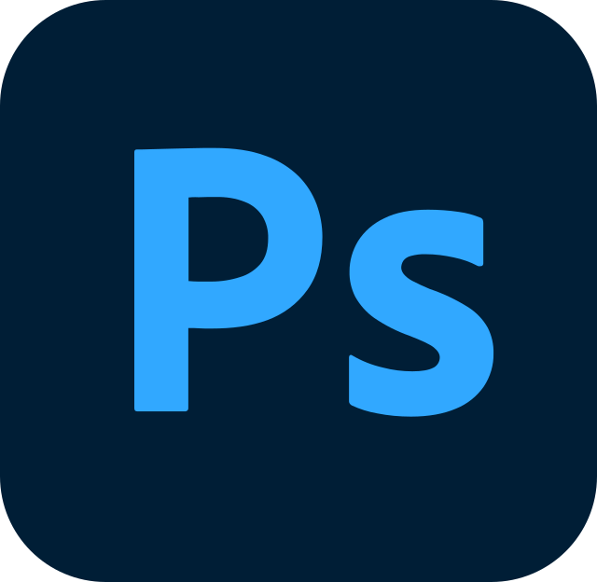
Applications for Graphic Design
Adobe Photoshop

